Slide 1
Greek Verb: Voices
Prof. Vanessa Gorman
University of Nebraska-Lincoln
vgorman1@unl.edu

Slide 2
Finite Verbs
Analysis includes 5 pieces of information
Person = 1st, 2nd, 3rd
Number = singular, plural, [dual]
Tense = present, imperfect, aorist, perfect, future, pluperfect, future perfect
Mood = indicative, imperative, subjunctive, optative
Voice = active, middle, passive; also deponent

Slide 3
Greek has three voices: active, middle, passive
Active = the subject is the agent of the verb
“Themistokles [SBJ] won [PRED] the battle [OBJ].”
Middle = the subject is the agent of the verb, but acts with some special reference to himself/herself
“Susan exercises.” [for her own benefit]
“Kimon pours a libation.” [for his own benefit, not for the city]
“The hoplite prepared [himself] for battle.”
Deponents are active verbs with middle/passive forms
μάχομαι, ἔρχομαι, γίγνομαι, etc.

Slide 4
Some verbs whose meanings change with voice
αἱρέω Act = take Mid = choose
αἰτέω Act = ask Mid = beg
μισθόω Act = hire out Mid = rent
χράω Act = give an oracle Mid = consult an oracle
φαίνω Act = cause to appear Mid = seem

Slide 5
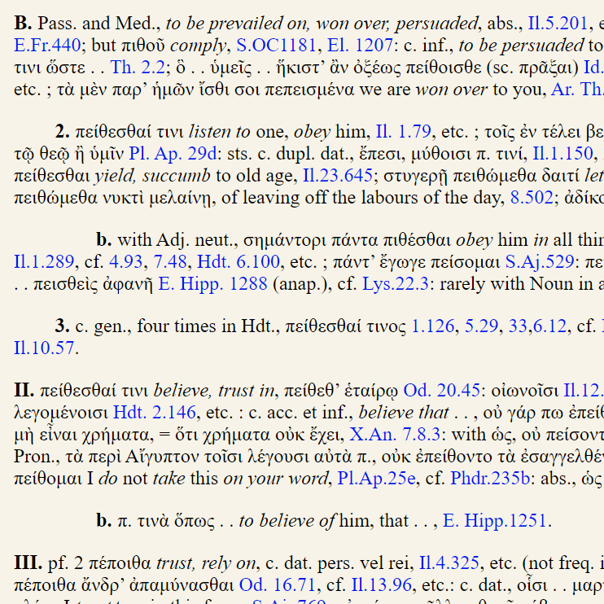
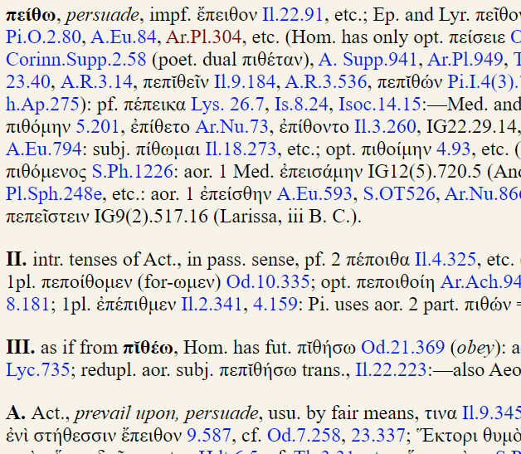
Use the LSJ to find the meanings in different voices

Slide 6
Passive Voice
What had been the direct OBJ becomes the SBJ
What had been the SBJ become the agent [human] is usually expressed by a prepositional phrase ὑπό + gen [“by x”] = OBJ [necessary argument]
The instrument [thing; ADV] is expressed with a dative of instrument/means [ADV].
ACTIVE = “Themistocles [SBJ] killed him [OBJ] with a club [ADV].”
PASSIVE
“He [SBJ] was killed [PRED] by Themistokles [OBJ].”
“He [SBJ] was killed [PRED] with a club [ADV].”
“He [SBJ] was killed [PRED] by Themistokles [OBJ] with a club [ADV].”

Slide 7
Voice and Tense
In the present and perfect stems, the same form represents both middle and passive [medio-passive]
They must be distinguished by context
ὑπό + gen agent = passive
Aorist and Future have different forms for the middle and passive

Slide 8
Common forms in Greek
Aorist active, middle, passive
Imperfect active, M/P
Present active, M/P
Less common
Perfect active, M/P
Future active, middle

Slide 9
Summary: 3rd sg/pl
Deponent, middle, and medio-passive 3rd person endings
-ται, -νται [primary endings]
-το, -ντο [secondary endings]
Aorist passive 3rd person endings
-θη
-θησαν
Sigma is the sign of the fut, impf, and aor
Kappa is the sign of the perf
Theta is the sign of the aor pass

Slide 10
Formation: Present Active > M/P
Present m/p = 1PP + -εται, -ονται
Same as present deponent = primary endings
πέμπω [act > MP]
πέμπει > πέμπεται
πέμπουσι(v) > πέμπονται
ἄρχω
ἄρχει > ἄρχεται
ἄρχουσι(v) > ἄρχονται
ποιέω
ποιεῖ > ποιεῖται
ἐποιουσι(ν) > ποιοῦνται
βάλλω
βάλλει > βάλλεται
βάλλουσι(ν) > βάλλονται

Slide 11
Formation: Imperfect Active > M/P
Present m/p = 1PP + -εται, -ονται
Same as present deponent = primary endings
Imperfect m/p = 1PP + augment + -ετο, -οντο
Same as imperfect deponent = secondary endings
πέμπω [act > MP]
ἔπεμπε(v) > ἐπέμπετο
ἔπεμπον > ἐπέμποντο
ἄρχω
ἦρχε(ν), > ἤρχετο
ἦρχον > ἤρχοντο
ποιέω
ἐποίει > ἐποιεῖτο
ἐποίουν > ἐποιοῦντο
βάλλω
ἔβαλε(v) > ἐβάλλετο
ἔβαλον > ἐβάλλοντο

Slide 12
Aorist Middle formed from 3rd PP Augment + stem + -σατο, -σαντο OR –ετο, -οντο
πέμπω, πέμψω, ἔπεμψα, πέπομφα, πέπεμμαι, ἐπέμφθην
ἐπέμψατο, ἐπέμψαντο
ἄρχω, ἄρξω, ἦρξα, ἦρχα, ἦργμαι, ἤρχθην
--, --
ποιέω, ποιήσω, ἐποίησα, πεποίηκα, ποποίημαι, ἐποιήθην
ἐποιήσατο, ἐποιήσαντο
βάλλω, βαλέω, ἔβαλον, βέβληκα, βέβλημαι, ἐβλήθην
ἐβάλετο, ἐβάλοντο

Slide 13
Aorist Passive formed from 6th PP Augment + stem + -θη, -θησαν
πέμπω, πέμψω, ἔπεμψα, πέπομφα, πέπεμμαι, ἐπέμφθην
ἐπέμφθη, ἐπέμφθησαν
ἄρχω, ἄρξω, ἦρξα, ἦρχα, ἦργμαι, ἤρχθην
ἤρχθη, ἤρχθησαν
ποιέω, ποιήσω, ἐποίησα, πεποίηκα, ποποίημαι, ἐποιήθην
ἐποιήθη, ἐποιήθησαν
βάλλω, βαλέω, ἔβαλον, βέβληκα, βέβλημαι, ἐβλήθην
ἐβλήθη, ἐβλήθησαν

Slide 14
REVIEW= Perfect ACTIVE tense 4PP = Reduplication + κ +3rd sg/pl endings = -ε(ν)/-ασι(ν)
πέμπω, πέμψω, ἔπεμψα, πέπομφα, πέπεμμαι, ἐπέμφθην
πέπομφε(v), πεπόμφασι(v)
ἄρχω, ἄρξω, ἦρξα, ἦρχα, ἦργμαι, ἤρχθην
ἦρχε(v), --
ποιέω, ποιήσω, ἐποίησα, πεποίη-κα, ποποίημαι, ἐποιήθην
πεπόηκε(v), πεποήκασιν
βάλλω, βαλέω, ἔβαλον, βέβλη-κα, βέβλημαι, ἐβλήθην
βέβληκε(v), --

Slide 15
Perfect M/P formed from 5th PP + primary endings Reduplication + stem + -ται, -νται
πέμπω, πέμψω, ἔπεμψα, πέπομφα, πέπεμμαι, ἐπέμφθην
πέπεμπται, --
ἄρχω, ἄρξω, ἦρξα, ἦρχα, ἦργμαι, ἤρχθην
ἦρκται, --
ποιέω, ποιήσω, ἐποίησα, πεποίηκα, ποποίημαι, ἐποιήθην
πεποίηται, πεποίηνται
βάλλω, βαλέω, ἔβαλον, βέβληκα, βέβλημαι, ἐβλήθην
βέβληται, βέβληνται

Slide 16
In sum: 3rd sg/pl
Deponent, middle, and medio-passive endings
-ται, -νται
-το, -ντο
Aorist passive
-θη
-θησαν
Sigma is the sign of the fut, impf, and aor
Kappa is the sign of the perf
Theta is the sign of the aor pass

Slide 17
Summary of most common forms

